Slide 1

RoboTour
A robot that improves your experience in museums
Notes:
Finn
This is RoboTour. RoboTour is a multi-purpose assistive robot tailored to museum visitors. Our mission is to provide a dynamic cultural experience for museum visitors through 2 unique value propositions:
Robot guiding assistance, for example, RoboTour take me to the newest painting. Where is the Picasso painting. Take me to the toilet?
Elimination of language barriers, RoboTour is a walking tour-guide which provides multi-language support. RoboTour will take you to the exhibitions that you want to see and in your primary language.
As outlined in our project plan, we have achieved 4 key milestones for demo 1: Basic Robot Building, App-to-Robot Communication, Basic UI Designs, and Basic Collision Avoidance.
For each of these milestone, our members will also talk about what’s next steps.

Slide 2
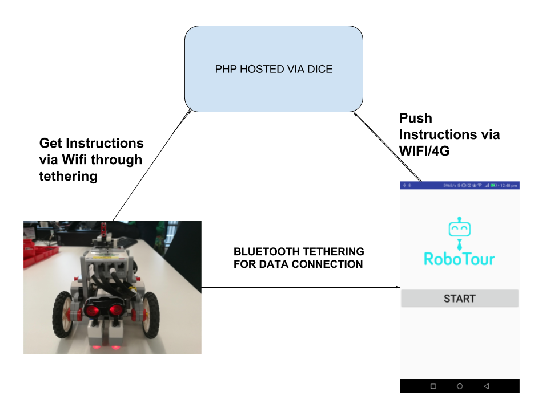
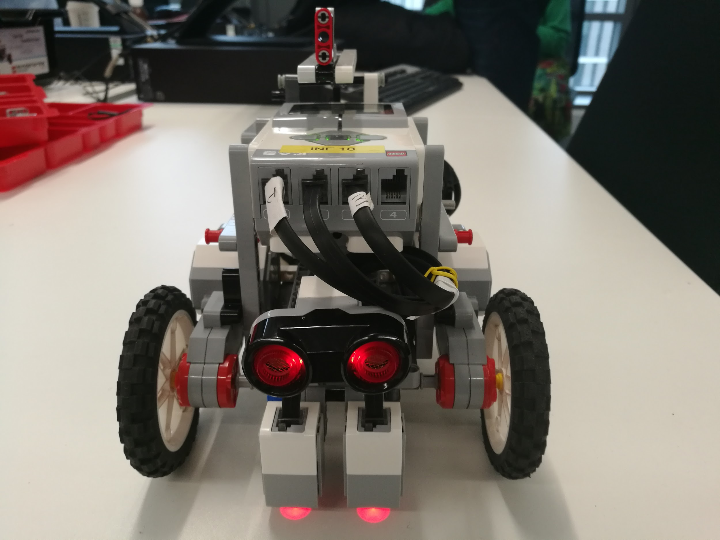
Recap of Demo 1
Basic Robot Building
App-to-Robot Communication

Slide 3
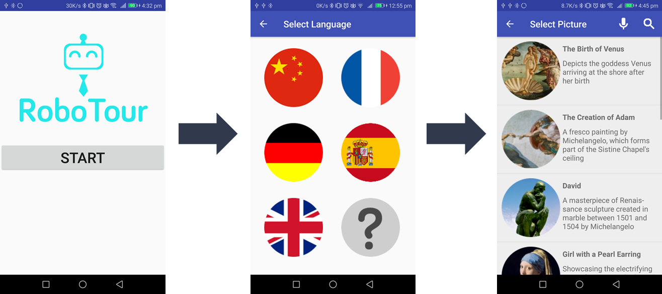
Recap of Demo 1
Completed Basic User Interface
Basic Collision Avoidance
Client Demo 1:
Stop when detects obstacles
Only apply at going forward
Using multithreading

Slide 4
Following line path
The robot can navigate simple branching line paths so that it reaches a predetermined destination.

Slide 5
Basic Speech Commands
The user can interact with the robot through the app via English speech. The user can send basic commands to the robot e.g. “Take me to X”.

Slide 6
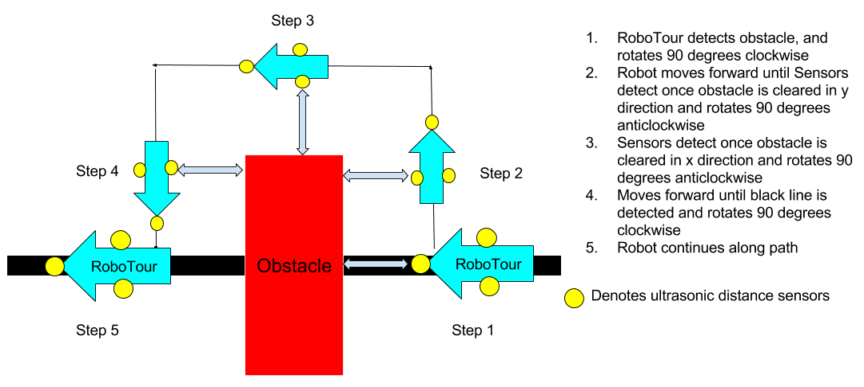
Dynamic collision avoidance and navigation

Slide 7
Motorised Robot Pointer
When RoboTour reaches an art piece, it points points to it.

Slide 8
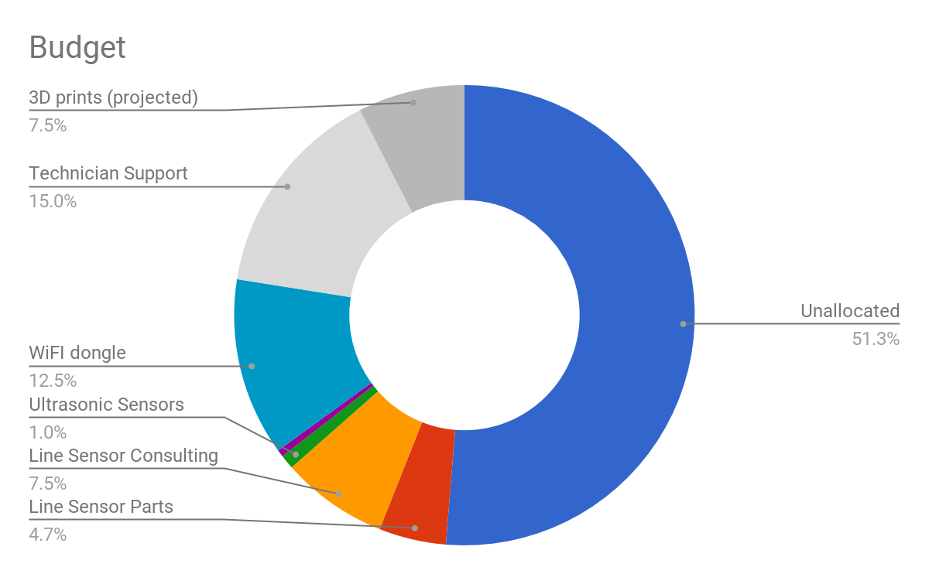
Resources/Member
Time Spent: 68 Remain: 132 (hrs/member)
Guest lectures: 3 (of 6)
Demonstrations 1 (of 4)
Group meetings: 11 (of 25)
Planning and Admin 16 (of 40)
Debugging & Testing: 10 (of 30)
Code Reviews: 2 (of 10)
Robot construction: 5 (of 10)
Code development 20 (of 75)
Money Spent: £23.43 Remain: £176.57
Microcontroller (ATMEGA88A-AU) £2.50
Sensor (KTIR 0711S) £0.00
Sensor (QRE1113GR) £5.64
Crystal (MCRS020000F1) £0.29
Line sensor (Technician Time) £15
Fig 13: Budget pie chart
Notes:
Michal
Main:
Conclusion: We are on schedule to completing tasks because it took us 50 hours/member of work each to get to this point

Slide 9
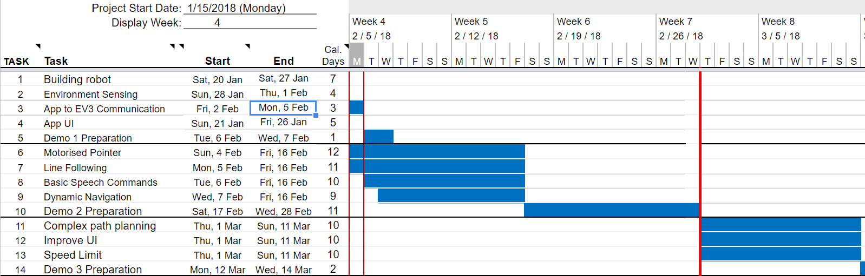
Plans Going Forward - Revised Gantt Chart
Fig 11: Gantt chart
Notes:
- Mariyana still ill and not in Edinburgh - We expected her to be back, but due to medical complications she hasn’t come back yet- hence we need to reshuffle
- We also reshuffled further according to each team members strengths
- We have done this to ensure that we we optimally use our time to produce the best quality work in an efficient manour.

Slide 10
Live Demonstration
Notes:
David

Slide 11
Next Steps
3.1.3 Client Demo 3 - 14/03/2018
Technical Achievement | Evidence
Speed Adjustment / Variable Speed | The robot is able to adjust the speed to the users’ requirements. Additionally, the robot stops if the connection drops or upon the the users request.
Improved User Interface | Allows the user to ask the robot for recommendations via text or speech. There will be a script of acceptable speech commands.
Complex Path Planning | The robot considers multiple paths between selected points and selects the one that minimises travel time.
Fig 12: Milestones for next client demo
Notes:
Here we have what we plan to have completed for Demo 2.
Address 4 points
The only difference with this is like Michal said we are building a custom line sensor for this demo.

Slide 12
Thank You
We would like to welcome any questions or suggestions that you may have.
Notes:
We would all like to thank you for listening to our demonstration. We would like to invite you to have a look at our current system and would welcome any questions or suggestions you may have.

